Slide 1



Introduction:
Hydraulic Fluid Management
by
Kleentek: Electrostatic Oil Cleaner
(SP Series)
Focus Machinery Pte Ltd, Singapore
x
Kleentek Corporation, Japan
Notes:
Hi, good day to you wherever you are joining me in this presentation from all over the world
And I would like to thank you for joining me in this short presentation over the next xx minutes - as I’ve to share more about us, what we do and Kleentek’s product can do for you.
I hope that with this short presentation, we will be able to spark some interest in you, and that we will be given the opportunities to further our discussion/engagement to the next level by meeting face-to-face next time.
Please note that this video presentation is not intended to replace face-to-face engagement/discussion - but to facilitate the whole process of the initial engagement on our first meeting.

Slide 2
How we operate and works
Step 1
Step 2
Step 3
Step 4
Client,
(You)
initial contact
expression of interest
initial discussion
benchmarking of oil performance (using Kleentek Oil Analysis report)
benchmarking of oil performance using independent laboratory
taking delivery of Kleentek’s Oil Cleaner
preparation of materials and resources
taking delivery of oil cleaner
implementation of oil management control
perform oil top-up and replenishment based on Kleentek’s recommendation
Focus Machinery
Pte Ltd,
Singapore
understanding of technical background, application
collection of oil samples, (used/new)
membrane patch testing, internal
negotiation of pricing and payment term
drafting of technical solution based on client’s environment
placement of order with the maker
commissioning, installation of system
boardroom presentation, on-site training
performance measurement
regular interval oil performance measurement
yearly onsite visit with customer,
Kleentek Corp Inc., Japan
maker informed of the client, enquiry
processing of oil samples
oil analysis report
maker produce the Kleentek machine with accordance to technical requirement
tentative lead time: approxi. 3 months
oil samples are sent back to Kleentek Corp Inc., Japan for oil analysis
provide recommendation based on the oil analysis
feedback on the performance of client’s environment
provide recommendation and feedback on client’s environment
Copyright 2024 © Focus Machinery Pte Ltd. All Rights Reserved.
Notes:
In this slide - this is breakdown, summary of our typical engagement with the majority of our customers.
Because the complexity of each and every of our customers is different, and that we’re also learning as we work - we therefore pay very close attention to the development of each and every of our customers very closely.

Slide 3
Application of Kleentek: Electrostatic Oil Cleaner
Type of Lubricant/Oil
Specific Application
Hydraulic Press; Casting Machine; Forging Machine; Injection Molding; Steel Mill/Paper Mill; Gauge Control System (Steel, Aluminums, Paper); Governor Control (Power Plant); Machining Centers; Test Stand Simulator
Hydraulic Oil
VG22 ~ 68
Mechanical Press Machine; Gas & Steam Turbines (Power Plants); Paper dryer bearing; vacuum pumps;
Lubricant
VG68 ~ 200
Power Plants
Turbine Oil
Summary:
Application Oil : Mineral based oil with the exception of engine oil
Viscosity : below 200mm²/s
Temperature : below 60°C
Copyright 2024 © Focus Machinery Pte Ltd. All Rights Reserved.
Notes:
In this slide - I’ve included a summary of the area of application that Kleentek: Electrostatic Oil Cleaner that it could be applied to - in the areas of refining mineral based oil for lubrication purpose.
These are just a small segment of the application, as there are more sectors - such as aviation, utilities and electrical power grid - which we’ve not covered.

Slide 4
Value Proposition of Kleentek: Electrostatic Oil Cleaner (“EOC”)
To promote sustainable practice through
the reduced use of non-renewable natural resource
by refocusing the use refined mineral oil
while ensuring maximum uptime;
reduce cost of maintenance
and minimizing operational impact.
Copyright 2024 © Focus Machinery Pte Ltd. All Rights Reserved.
Notes:
The primary objective of using Kleentek’s product would be to achieve cost saving by reducing the frequency of expensive oil purchases, achieving maximum operational/engineering hours.
In this day and age - in addition to cost saving, increase in performance reliability and environmental protection, we are also concerned about the sustainable practice of non-renewable resources.

Slide 5
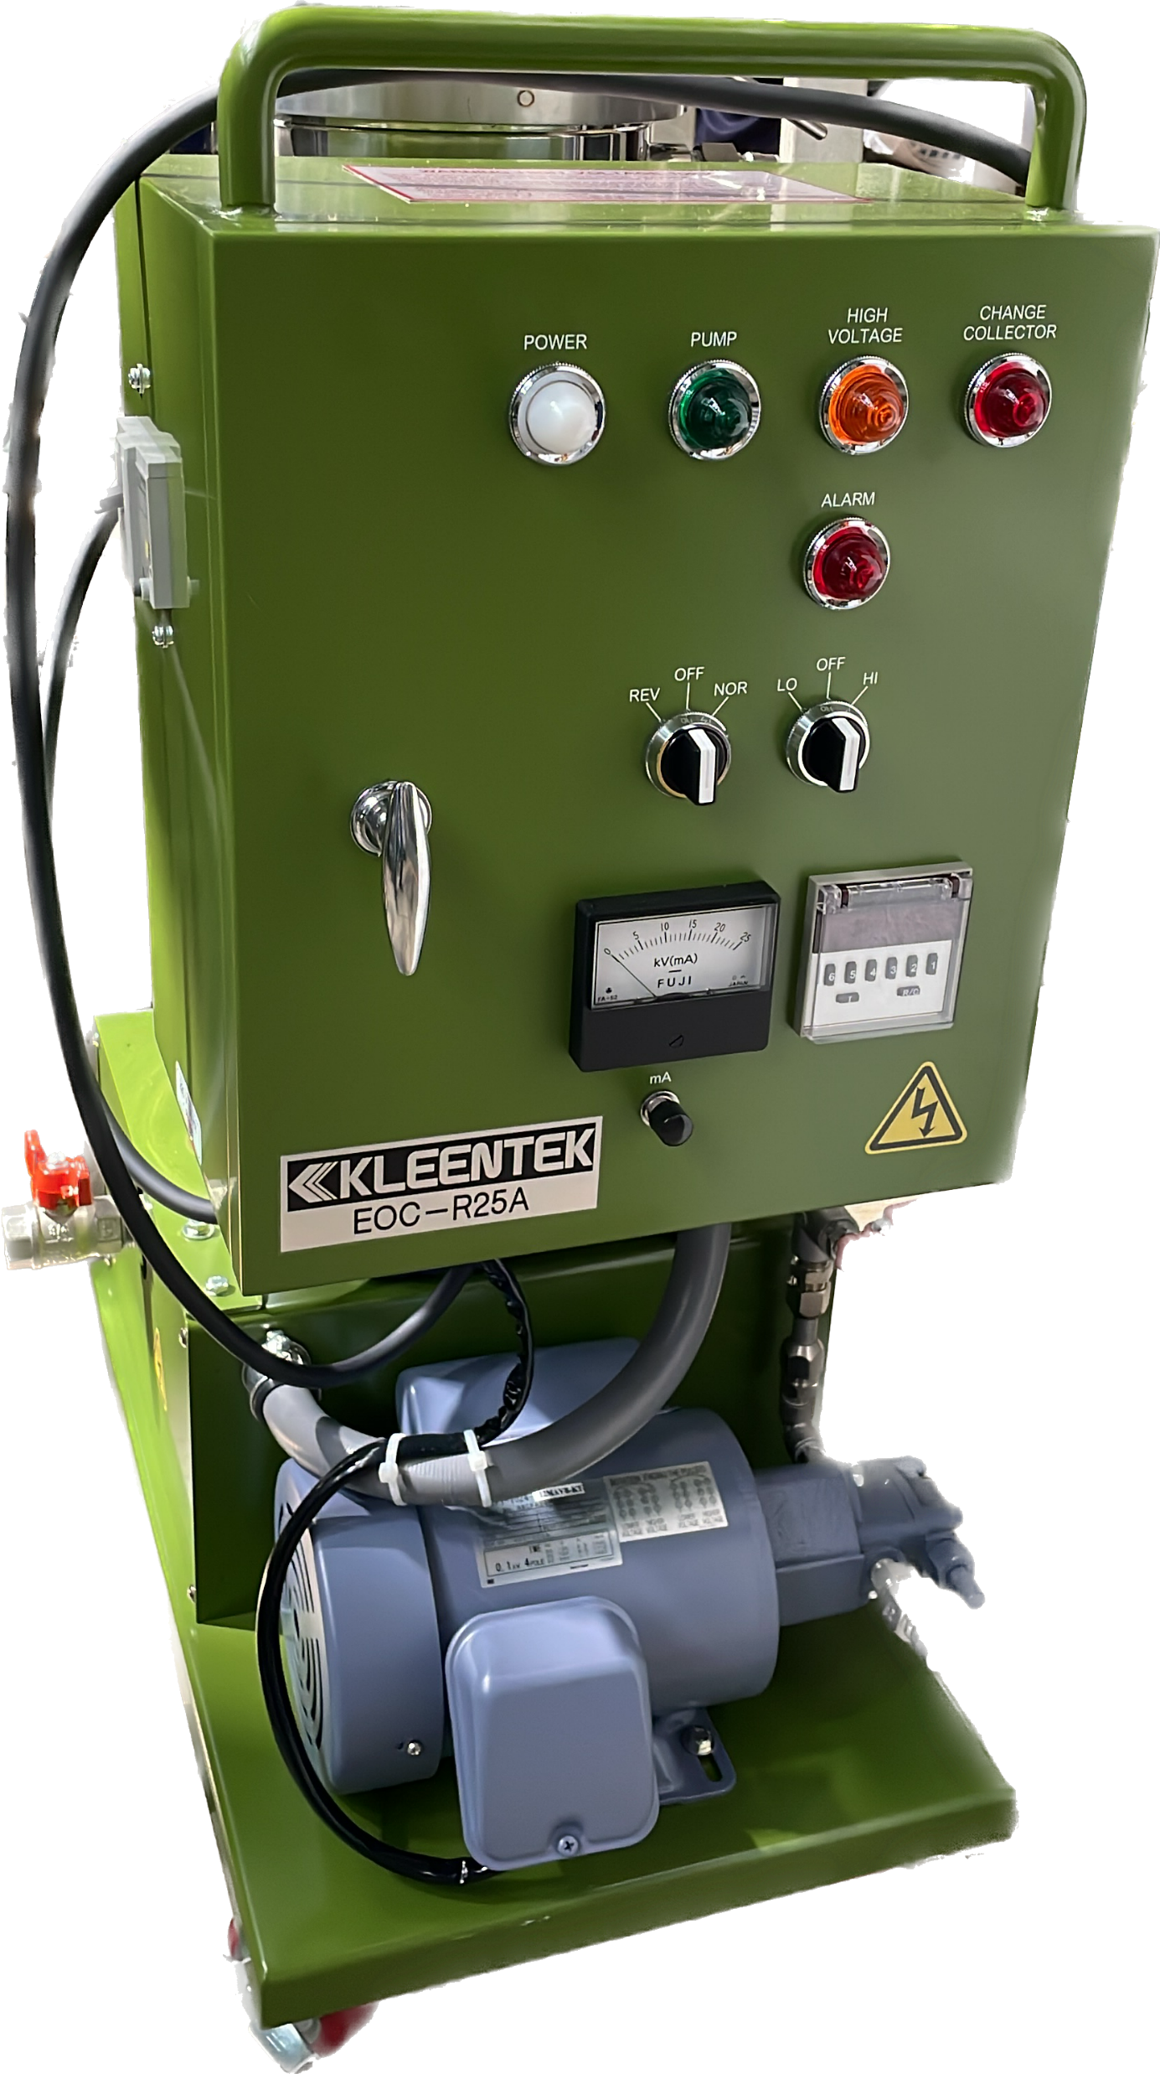

Working Principle of EOC
Operating Principle of EOC
Contaminants within the oil are charged using the electrode. The charged particles will move towards the electrode having opposite polarity.
EOC has the ability to eliminates any kinds and sizes of contaminants including sub-micron contaminants
Combined both the principle of electrophoresis & dielectrophoresis
Patented designed collectors materials that deforms the electrical field and neutral contaminants are attracted to the strongest field region (Dielectrophoresis)
Free-flowing of the fluid within the cleaning chamber. No pressure differences between the bottom and the top of the cleaning chamber
Copyright 2024 © Focus Machinery Pte Ltd. All Rights Reserved.
Notes:
In the next few slides, I would give a brief introduction of what made Kleentek’s patented technology its edges as compared to its competitors and verse traditional and conventional in-line filters.
In this slide, this is a model of the EOC-R25A, of the more commonly sized/used model that is used to cater for the application in the injection molding - manufacturing industry.

Slide 6
Working Principle of EOC
Operating Principle of EOC
applied voltage of 10kV
Contaminants within the oil are charged using the electrode. The charged particles will move towards the electrode having opposite polarity.
Direction of movement of the positively charged particles
EOC has the ability to eliminates any kinds and sizes of contaminants including sub-micron contaminants
positively
charged
particles
Combined both the principle of electrophoresis & dielectrophoresis
Negative
Electrode
Patented designed collectors materials that deforms the electrical field and neutral contaminants are attracted to the strongest field region (Dielectrophoresis)
Positive
Electrode
direction of oil flow
direction of oil flow
neutral
particles
Free-flowing of the fluid within the cleaning chamber. No pressure differences between the bottom and the top of the cleaning chamber
Direction of movement of the negatively charged particles
negatively
charged
particles
Copyright 2024 © Focus Machinery Pte Ltd. All Rights Reserved.
Notes:
On the left of this slide - this is an illustration of the cross-sectional diagram of the cleaning chamber of the EOC, or what you called a schematic diagram of the cleaning chamber.
[Ref: First point #1]: Contaminants within the oil are charged using an electrode - driven by a high-voltage. The particles as indicated by the red circle and the yellow circles are both positively and negatively charged and will move toward the negative electrode and the positive electrode.

Slide 7
Working Principle of EOC
Operating Principle of EOC
applied voltage of 10kV
Contaminants within the oil are charged using the electrode. The charged particles will move towards the electrode having opposite polarity.
Direction of movement of the positively charged particles
EOC has the ability to eliminates any kinds and sizes of contaminants including sub-micron contaminants
Combined both the principle of electrophoresis & dielectrophoresis
Negative
Electrode
Patented designed collectors materials that deforms the electrical field and neutral contaminants are attracted to the strongest field region (Dielectrophoresis)
Positive
Electrode
direction of oil flow
direction of oil flow
Free-flowing of the fluid within the cleaning chamber. No pressure differences between the bottom and the top of the cleaning chamber
Direction of movement of the negatively charged particles
Copyright 2024 © Focus Machinery Pte Ltd. All Rights Reserved.
Notes:
[Ref: Second point #2]:
The most important advantage an electrostatic oil cleaner has over conventional and traditional filters is its ability to eliminate sub-micron contaminants of any kinds and sizes of contaminants.
[Ref: Third point #3]:
This process of movement of the positively and negatively charged contaminant is also known as the electrophoresis.

Slide 8
Working Principle of EOC
Operating Principle of EOC
applied voltage of 10kV
Contaminants within the oil are charged using the electrode. The charged particles will move towards the electrode having opposite polarity.
Direction of movement of the positively charged particles
EOC has the ability to eliminates any kinds and sizes of contaminants including sub-micron contaminants
Combined both the principle of electrophoresis & dielectrophoresis
Negative
Electrode
Patented designed collectors materials that deforms the electrical field and neutral contaminants are attracted to the strongest field region (Dielectrophoresis)
Positive
Electrode
direction of oil flow
direction of oil flow
Free-flowing of the fluid within the cleaning chamber. No pressure differences between the bottom and the top of the cleaning chamber
Direction of movement of the negatively charged particles
Copyright 2024 © Focus Machinery Pte Ltd. All Rights Reserved.
Notes:
[Ref: Third point #3]:
This process of movement of the positively and negatively charged contaminant is also known as the electrophoresis.

Slide 9
Working Principle of EOC
Operating Principle of EOC
Contaminants within the oil are charged using the electrode. The charged particles will move towards the electrode having opposite polarity.
neutral
EOC has the ability to eliminates any kinds and sizes of contaminants including sub-micron contaminants
Combined both the principle of electrophoresis & dielectrophoresis
neutrally charged particles are attracted to tip of collector
Patented designed collectors materials that deforms the electrical field and neutral contaminants are attracted to the strongest field region (Dielectrophoresis)
Free-flowing of the fluid within the cleaning chamber. No pressure differences between the bottom and the top of the cleaning chamber
neutral
Copyright 2024 © Focus Machinery Pte Ltd. All Rights Reserved.
Notes:
Question: You might have to ask me, then what happens to the neutral particle that is not charged by the electrode in the oil.
[Ref: Third point #3]:
The second process of movement of neutral particles within the field created by the electrostatic field is also known as dielectrophoresis.

Slide 10
Working Principle of EOC
Operating Principle of EOC
Contaminants within the oil are charged using the electrode. The charged particles will move towards the electrode having opposite polarity.
EOC has the ability to eliminates any kinds and sizes of contaminants including sub-micron contaminants
neutral
Combined both the principle of electrophoresis & dielectrophoresis
neutrally charged particles are attracted to tip of collector
Patented designed collectors materials that deforms the electrical field and neutral contaminants are attracted to the strongest field region (Dielectrophoresis)
neutral
Free-flowing of the fluid within the cleaning chamber. No pressure differences between the bottom and the top of the cleaning chamber
Copyright 2024 © Focus Machinery Pte Ltd. All Rights Reserved.
Notes:
[Ref: Third point #3]:
The second process of movement of neutral particles within the field created by the electrostatic field is also known as dielectrophoresis.

Slide 11
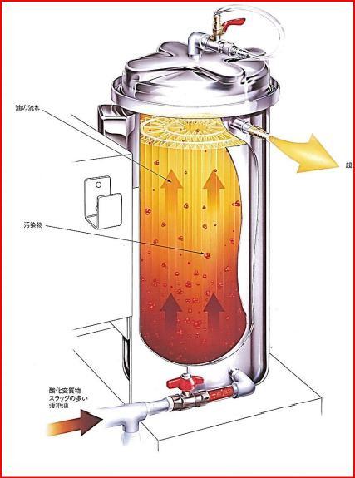
Working Principle of EOC
Operating Principle of EOC
Contaminants within the oil are charged using the electrode. The charged particles will move towards the electrode having opposite polarity.
EOC has the ability to eliminates any kinds and sizes of contaminants including sub-micron contaminants
Combined both the principle of electrophoresis & dielectrophoresis
Patented designed collectors materials that deforms the electrical field and neutral contaminants are attracted to the strongest field region (Dielectrophoresis)
Free-flowing of the fluid within the cleaning chamber. No pressure differences between the bottom and the top of the cleaning chamber
Copyright 2024 © Focus Machinery Pte Ltd. All Rights Reserved.
Notes:
On the last point - we would like to inform our customer that the fluid in the cleaning chamber of the EOC is free-flowing, and that the pump that comes attached with the unit is a very slow flow rate pump that is used to move the fluid through the cleaning chamber.

Slide 12
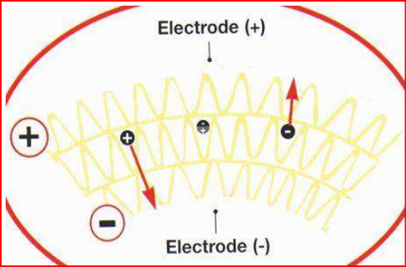
Working Principle of EOC
Operating Principle of EOC
Contaminants within the oil are charged using the electrode. The charged particles will move towards the electrode having opposite polarity.
EOC has the ability to eliminates any kinds and sizes of contaminants including sub-micron contaminants
Combined both the principle of electrophoresis & dielectrophoresis
Patented designed collectors materials that deforms the electrical field and neutral contaminants are attracted to the strongest field region (Dielectrophoresis)
Free-flowing of the fluid within the cleaning chamber. No pressure differences between the bottom and the top of the cleaning chamber
Copyright 2024 © Focus Machinery Pte Ltd. All Rights Reserved.
Notes:
In this diagram, this is another cross-section diagram of the electrode (both positive electrode and the negative electrode) of the metal plate of the cartridge collector.

Slide 13
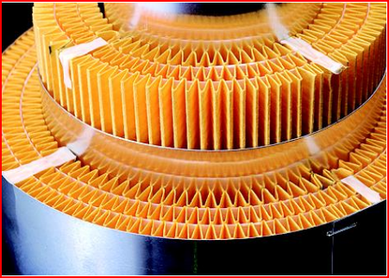
Working Principle of EOC
Operating Principle of EOC
Contaminants within the oil are charged using the electrode. The charged particles will move towards the electrode having opposite polarity.
EOC has the ability to eliminates any kinds and sizes of contaminants including sub-micron contaminants
Combined both the principle of electrophoresis & dielectrophoresis
Patented designed collectors materials that deforms the electrical field and neutral contaminants are attracted to the strongest field region (Dielectrophoresis)
Free-flowing of the fluid within the cleaning chamber. No pressure differences between the bottom and the top of the cleaning chamber
Honeycomb Structure
Copyright 2024 © Focus Machinery Pte Ltd. All Rights Reserved.
Notes:
In this slide, on the diagram on the left - you will see the Kleentek patented design of the Honeycomb like structure of the cartridge collectors. If you can see that the fluid/oil/lubricant flowing in the cleaning chamber is a free-flowing motion, there is no pressure difference at the start of the cleaning chamber and the end of the cleaning chamber.

Slide 14
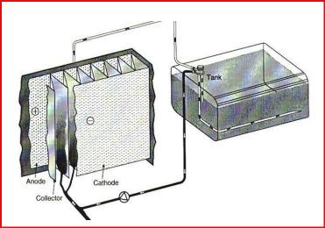
5. Implementing and Operating EOC
Implementing, Operating and Running your EOC
Simple, quick and straightforward Implementation and Installation
No modification to your existing machine/system is required
Promote Active-Active (“online”)/Active-Passive (“off-line”) setup, no downtime is required for mission-critical application
Just connect the power supply, one inlet and return hose to and from your Kleentek, Electrostatic Oil Cleaner, and your system will be up and running in no time
Copyright 2024 © Focus Machinery Pte Ltd. All Rights Reserved.
Notes:
In this slide, we will talk about the implementation, operation and running of your EOC. You will see that other than connecting a power supply from a power source to the oil cleaner, you will just need to connect an inlet/outlet hose to your hydraulic oil tank - in order to ingress and egress the process/cleaned oil from the electrostatic oil cleaner to the hydraulic oil tank.
In this cross-sectional diagram, you will see that oil is flowing in an unrestricted manner through the cartridge collector that has a high-voltage applied at the various metal plates on the collectors.
No modification to your primary system is required, you can clean your system in an active-active manner or active-passive manner.

Slide 15
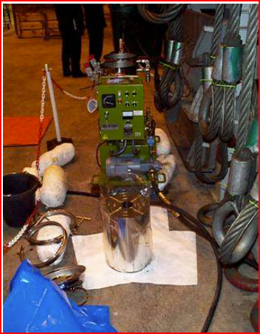
Implementing and Operating EOC
Change of Kleentek: Cartridge Collector
Cartridge Collectors are replaced every 2,000 hours
Necessary to ensure maximum cleaning efficiency
Procedure requires only 30 minutes
Primary machine is not require to shutdown
Copyright 2024 © Focus Machinery Pte Ltd. All Rights Reserved.
Notes:
So now, I believe you have a question for me: How about maintaining the oil cleaner, routine change.
In this slide, we’ve summarized the points that you required.
In just four simple steps, you will be able to change out your used Kleentek: Cartridge Collector upon reaching its lifespace.

Slide 16

Comparison between using an EOC vs Conventional in-line Filter
Using a Traditional and Conventional in-line Filter
Using a Kleentek: Electrostatic Oil Cleaner
No clogging of the Kleentek Cartridge Collectors upon reaching it lifespan of approximately 2,000 hours
Note: depending on the level of contamination
Replace line-filter when clogging occurs
Removal of sub-micron particles and oil oxidation products that accounts for 70% of the contaminations that take place in a hydraulic system
Change of oil when hydraulic failures occurs
Change of oil when oil providers recommends a oil change
(without system flushing)
Removal of oil oxidation product from the surface of the internal component without removal of complex components
Oil change continue to be part of the requirement of the preventive maintenance schedule with accordance to majority of the manufacturer – environmentally not sustainable
No oil change is would be required
Note: small quantity of oil (5% to 10%) top-up would be required in order to replenish the drop in level of oil additive and due to depletion of oil samples for testing
Remove up to micro-level particles (6µm) sized particles only. This is equivalent of particle sized up fine iron oxide
Ability to remove up to sub-micro level particles (0.03µm) sized particles. This is equivalent of up to carbon sized particles at a microscopic level.
Copyright 2024 © Focus Machinery Pte Ltd. All Rights Reserved.
Notes:
In this summarized table, we will have a quick, and short comparison between using a traditional and conventional in-line filter, and using Kleentek: a Electrostatic Oil Cleaner.
In summary, using a Kleentek: Electrostatic Oil Cleaner is a preferred choice, since it is an active system that continuous cleans not only your oil, but also the varnish, the oil oxidation products from your system - ensuring that your primary system runs smoothly, first time and all of the time.

Slide 17
Advantage of Using Electrostatic Oil Cleaner (“EOC”)
Measures
Details
Productivity
reduce machine downtime
reduce the no. of defective parts produce
ensure consistent and high-quality of manufactured parts
Environment
extend life of lubricating fluid/oil used
encourage energy saving
reduce oil leakage – from components and oil seals
Cost Reduction
reduce freq. and vol. of oil purchases, disposing of expenses
reduce cost of maintenances of equipment
reduce and eliminate the occurrence of servo value failure and pump failure
Sustainability
reduce the use of non-renewable natural resources
refocus of refined minerals oil/lubricant
promote the use of sustainable practices
Copyright 2024 © Focus Machinery Pte Ltd. All Rights Reserved.
Notes:
Finally, we come to the benefits of using an Electrostatic Oil Cleaner; there are four (“4”) primary main advantages that it will bring to your organization when you implement EOC, as part of your PM (preventive maintenance) cycle.
First - it will bring increased productivity to your organization, as it helps to reduce your machine downtime, and reduces the no. of defect parts produced for those who are in the manufacturing segment. It will also ensure that your moulding machine produces consistent, high-quality manufactured products/parts.
Second - by extending the life of your oil/lubricating fluid, you not only help me to reduce the frequency and volume of fluid used, but also reduces your operating expenses.
This only helps to reduce your cost of maintenance and helps to eliminate the occurrence of servo valve failure and pump failure.
Next, given the occurrence of events that are taking place around the globe - implementing EOC helps to reduce the use of non-renewable natural resources, and we redefine and refocus the use of refined minerals oil/lubricant. This is a small part that you can embark on as part of your sustainable practices.

Slide 18
Case Study – Tokyo Motomotive Co., Ltd, Japan
Customer,
Region:
Tokyo Motormotives Co., Ltd
Tokyo Shinangawa
Department:
Engineering and Production Facilities
Maintenance Department
Equipment:
Hydraulic Press Machine
Qty: 5 units
Vol. of Oil Tank: 4,000 litres
Operating Parameters:
Operating Temp: 45ºC
Lubri. Brand & Grade: Shell Tellus, VG46
Current Practice:
Oil Change Cycle: once every 2 years
Line Filter Replacement: once every year
Challenges:
Hydraulic Failures
Value Replacement: once every 3 years
Pump Malfunction: once every 2 years
Copyright 2024 © Focus Machinery Pte Ltd. All Rights Reserved.
Notes:
In this slide, we would like to present a case study that our manufacturer had engaged with Toyo Motomotive Co., Ltd - Japan. This is the profile of their oil change practice and routine and equipment list as well as their oil brand, grade, volume and frequency of oil change.

Slide 19

Case Study – Tokyo Motomotive Co., Ltd, Japan – Cost Benefits Analysis
w/o Kleentek Implementation
(USD)
with Kleentek Implementation
(USD)
Cost saving
(Dollars/year)
(USD)
Item
Description of Content
servo valve
replacement
average 3 times a year
(@USD 6,250/year)
18,750
0
18,750
cost of oil replacement
$\frac{7,000 litres }{3 years}$ $=2,333litres/year$
9,333
0
9,333
$$2,333 litres×USD 4.00=USD 9,333$$
cost of collector per year
replacement of collector
twice per year @
USD 820 per collector
0
1,640
-1,640
oil addition
(recommended)
5% of tank capacity of 7,000 litres
(7,000 litres x 5% = 350 litres)
(350 litres x USD4.00 = USD1,400.00)
0
1,400
-1,400
energy saving
reduce 5% of power consumption of hydraulic pump motor
417kW (150kW x 2 machine x 95 x 22kW
(417kW X 46% X 18h X 22 days X 12 months X 5% X USD013USD/kWh)
118,500
112,580
5,920
Total Saving
146,580
115,620
30,960
Copyright 2024 © Focus Machinery Pte Ltd. All Rights Reserved.
Notes:
In this slide, I would like to illustrate the total cost of operation of their organization without the implementation of Kleentek: Electrostatic Oil Cleaner. Please note the denomination of the values are all in USD.

Slide 20
Case Study – Tokyo Motomotive Co., Ltd, Japan – Cost Benefits Analysis
w/o Kleentek Implementation
(USD)
with Kleentek Implementation
(USD)
Cost saving
(Dollars/year)
(USD)
Item
Description of Content
servo valve
replacement
average 3 times a year
(@USD 6,250/year)
18,750
0
18,750
cost of oil replacement
$\frac{7,000 litres }{3 years}$ $=2,333litres/year$
9,333
0
9,333
$$2,333 litres×USD 4.00=USD 9,333$$
cost of collector per year
replacement of collector
twice per year @
USD 820 per collector
0
1,640
-1,640
oil addition
(recommended)
5% of tank capacity of 7,000 litres
(7,000 litres x 5% = 350 litres)
(350 litres x USD4.00 = USD1,400.00)
0
1,400
-1,400
energy saving
reduce 5% of power consumption of hydraulic pump motor
417kW (150kW x 2 machine x 95 x 22kW
(417kW X 46% X 18h X 22 days X 12 months X 5% X USD013USD/kWh)
118,500
112,580
5,920
Total Saving
146,580
115,620
30,960
Copyright 2024 © Focus Machinery Pte Ltd. All Rights Reserved.
Notes:
In this slide, I would like to illustrate the total cost of operation of their organization with the implementation of Kleentek: Electrostatic Oil Cleaner.

Slide 21
Case Study – Tokyo Motomotive Co., Ltd, Japan – Cost Benefits Analysis
w/o Kleentek Implementation
(USD)
with Kleentek Implementation
(USD)
Cost saving
(Dollars/year)
(USD)
Item
Description of Content
servo valve
replacement
average 3 times a year
(@USD 6,250/year)
18,750
0
18,750
cost of oil replacement
$\frac{7,000 litres }{3 years}$ $=2,333litres/year$
9,333
0
9,333
$$2,333 litres×USD 4.00=USD 9,333$$
cost of collector per year
replacement of collector
twice per year @
USD 820 per collector
0
1,640
-1,640
oil addition
(recommended)
5% of tank capacity of 7,000 litres
(7,000 litres x 5% = 350 litres)
(350 litres x USD4.00 = USD1,400.00)
0
1,400
-1,400
energy saving
reduce 5% of power consumption of hydraulic pump motor
417kW (150kW x 2 machine x 95 x 22kW
(417kW X 46% X 18h X 22 days X 12 months X 5% X USD013USD/kWh)
118,500
112,580
5,920
Total Saving
146,580
115,620
30,960
Copyright 2024 © Focus Machinery Pte Ltd. All Rights Reserved.
Notes:
Finally, in the final column, I’ve included the total cost saving from the implementation of Kleentek: Electrostatic Oil Cleaner that is achieved from their organization.

Slide 22
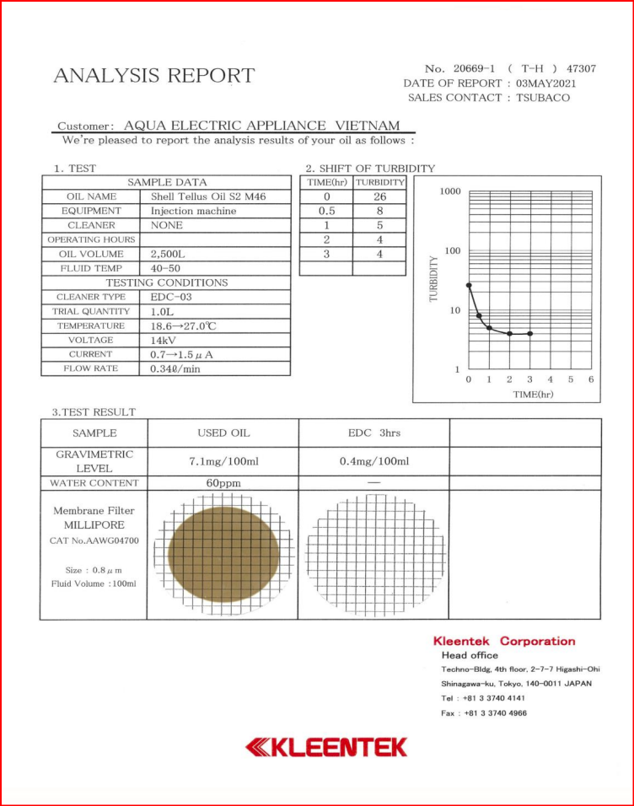
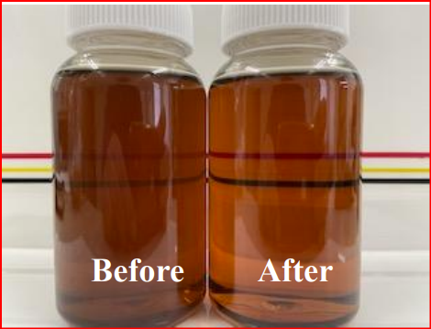
Case Study – Tokyo Motomotive Co., Ltd, Japan (cont.)
Sample Oil
Copyright 2024 © Focus Machinery Pte Ltd. All Rights Reserved.
Notes:
In this slide, we would like to illustrate the oil performance before and after using Kleentek: Electrostatic Oil Cleaner - and the result that we’ve obtained from our maker in-house laboratory.

Slide 23


For more information, you may reach us at:
WRITE TO US
sales@focusmachinery.com.sg
enquiry@focusmachinery.com.sg
VISIT US ONLINE
www.focusmachinery.com.sg
Copyright 2024 © Focus Machinery Pte Ltd. All Rights Reserved.
Notes:
Thank you for spending your time looking through this video presentation.
I hope that you’ve found the content that we’ve shared useful and beneficial to your operation.
Should you have any further queries, do reach out to us via the contact as shown.

